Slide 1


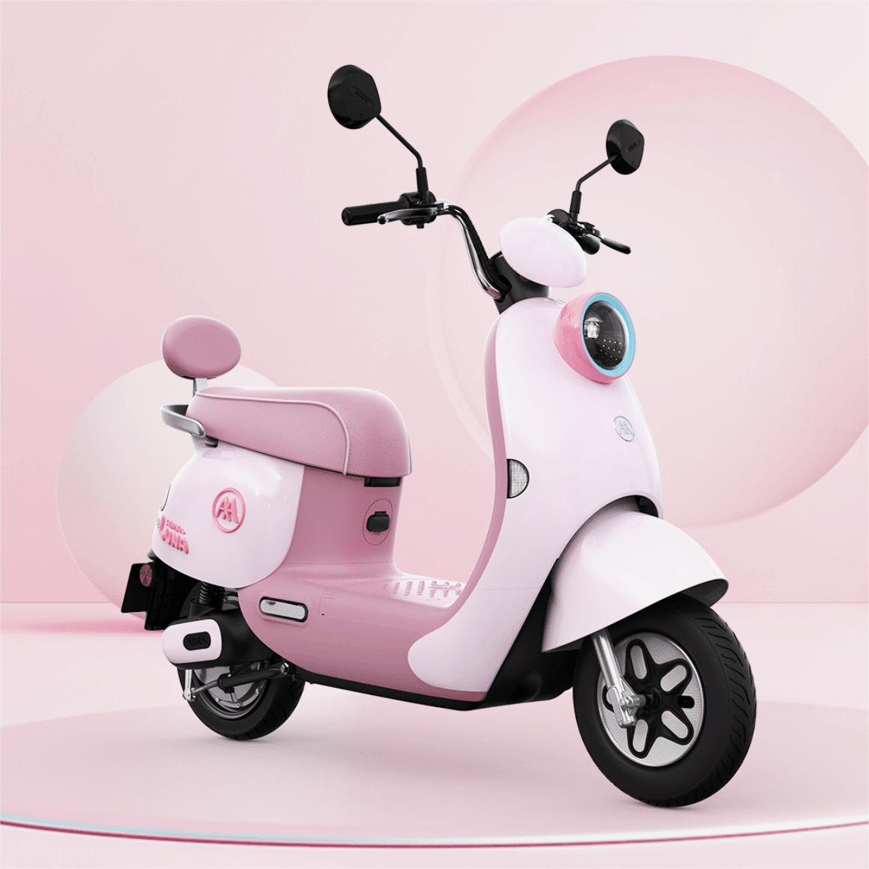
AIMA Electric Bicycle
Luna 2024 Product Report
MAR225 Group 2
Group members： Cecilia Judy Rin Elyse
Reporters: Cecilia Rin

Slide 2
01
Product Sheet
catalog
02
Product Comparison Sheets
03
Successful case

Slide 3
01
Product Sheet

Slide 4
Product Sheets
Products Overview
Product features
Streamlined body design
colorful
comfort
Intelligent control system
Advanced electric technology
Humanized design
High appearance level appearance
Innovation points
Others
Draw inspiration from water
Cycling comfort
Intelligent interconnection
Chassis anti-collision armor
Long battery life and less charging
Good after-sales service
Rich in color

Slide 5
02
Product Comparison Sheets

Slide 6
Product comparison Sheets
Comparison between AIMA LUNA and different products of the same brand

Slide 7
Product comparison Sheets
Comparison between AIMA LUNA and the latest electric bicycles from other brands

Slide 8
03
Successful case

Slide 9


I am a user of an old product and would like to switch to a new product of your brand recently. Your old product has less legroom during cycling, will there be any improvements to your new product?
Our new product LUNA 2024 has improved the legroom from 36.5cm in the old product to 60cm, making users more comfortable while riding.
The new product LUNA 2024 not only has a comprehensive upgrade in appearance and comfort, but also increases top speed and enhances safety. It can be more convenient to intelligently link with mobile phones.
Ok, I will place the order now and recommend it to my family and friends to also make purchases.

Slide 10
Value Concepts
Fashion
Environmental Protection
Brand concept of" fashionable car, fashionable stores, fashionable people"
Breaking through industry homogenization and creating explosive products
Protect the environment, save energy, implement clean production, and be committed to sustainable development
Adopt a zero-emission technology

Slide 11
THANK YOU
FOR LISTENING
MAR225 Group 2
Group members： Cecilia Judy Rin Elyse
Reporters: Cecilia Rin

